Slide 1
Intro to DS Project: Stroke Prediction
Stefan Roata, Zheng Zhiwei (Mike)

Slide 2

1. Introduction

Slide 3
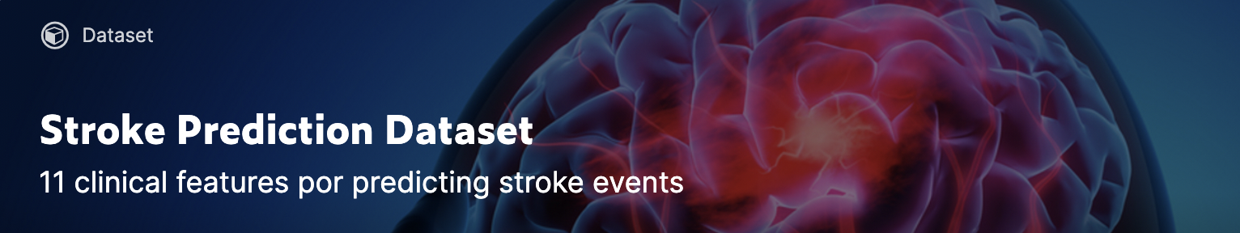
Project Introduction
Context:
According to the World Health Organization, 15 million people suffer stroke worldwide each year. Of these, 5 million die and another 5 million are permanently disabled. High blood pressure contributes to more than 12.7 million strokes worldwide.
Given the percentage of stroke skyrocketed with a significant 11% each year, our team decided to further investigate the stroke population and establish a model for the purpose of prediction and prevention.
Data Set Selection:
The dataset (https://www.kaggle.com/fedesoriano/stroke-prediction-dataset) we have chosen is found on Kaggle and contains information about age, gender, BMI (and 7 other parameters) along with whether or not the patient has had a stroke. Each row in the dataset provides relevant information about each of the 5110 patients.
Source: http://www.strokecenter.org/patients/about-stroke/stroke-statistics/
The location where these data were collected, as well as the period of collection, remain undisclosed. The dataset is under a license called “Data files © Original Authors”, meaning that the dataset does not belong to the original uploader. The original source, as stated on Kaggle, is confidential and the use of this dataset is restricted to educational purposes only.

Slide 4
Data Structure Overview: Attribute Information
id: unique identifier
gender: "Male", "Female" or "Other"
age: age of the patient
hypertension: 0 if the patient doesn't have hypertension, 1 if the patient has hypertension
heart_disease: 0 if the patient doesn't have any heart diseases, 1 if the patient has a heart disease
ever_married: "No" or "Yes"
work_type: "children", "Govt_jov", "Never_worked", "Private" or "Self-employed"
Residence_type: "Rural" or "Urban"
avg_glucose_level: average glucose level in blood
bmi: body mass index
smoking_status: "formerly smoked", "never smoked", "smokes" or "Unknown"*
stroke: 1 if the patient had a stroke or 0 if not

Slide 5
Research Question:
What are the variables that best allow us to predict stroke for an individual? Is it possible to predict stroke using these variables?

Slide 6

2.
EDA Analysis

Slide 7
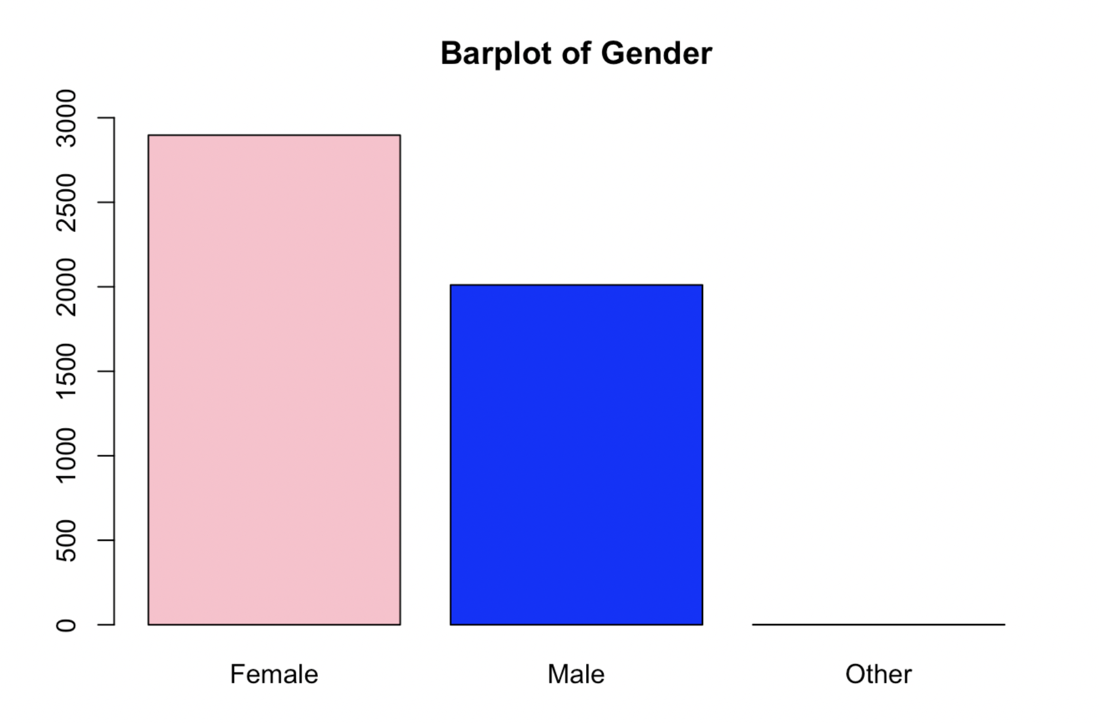
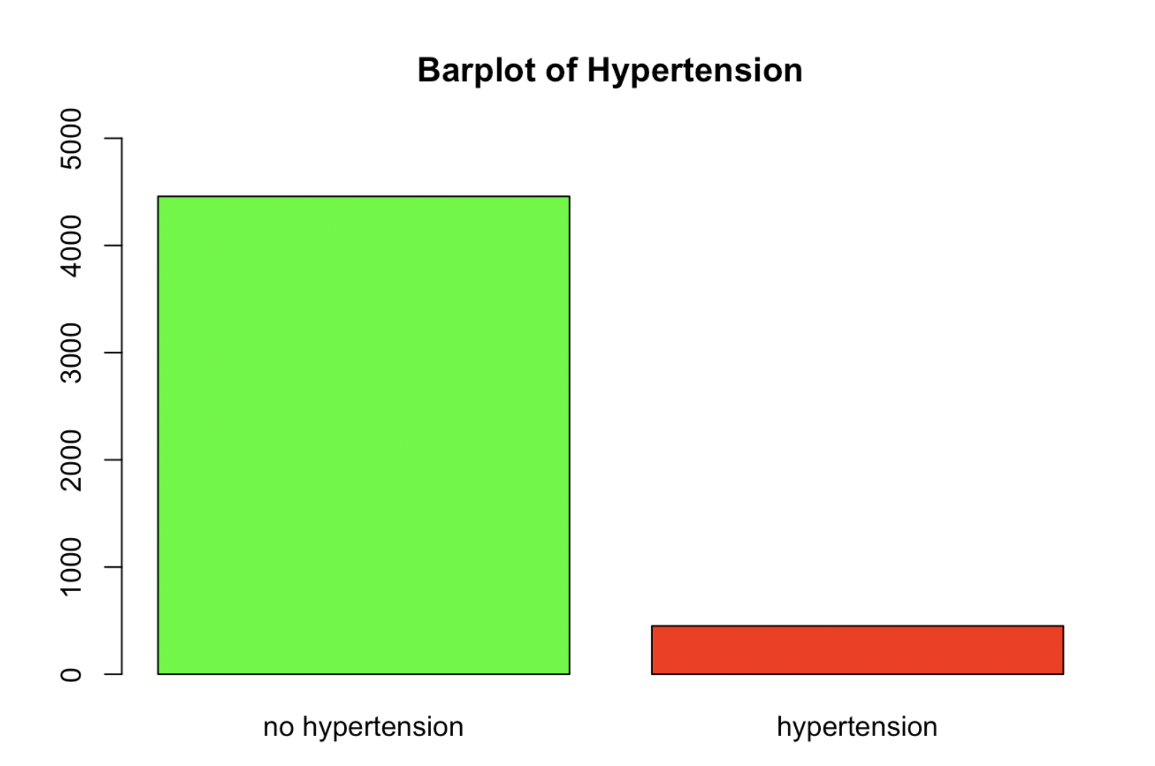
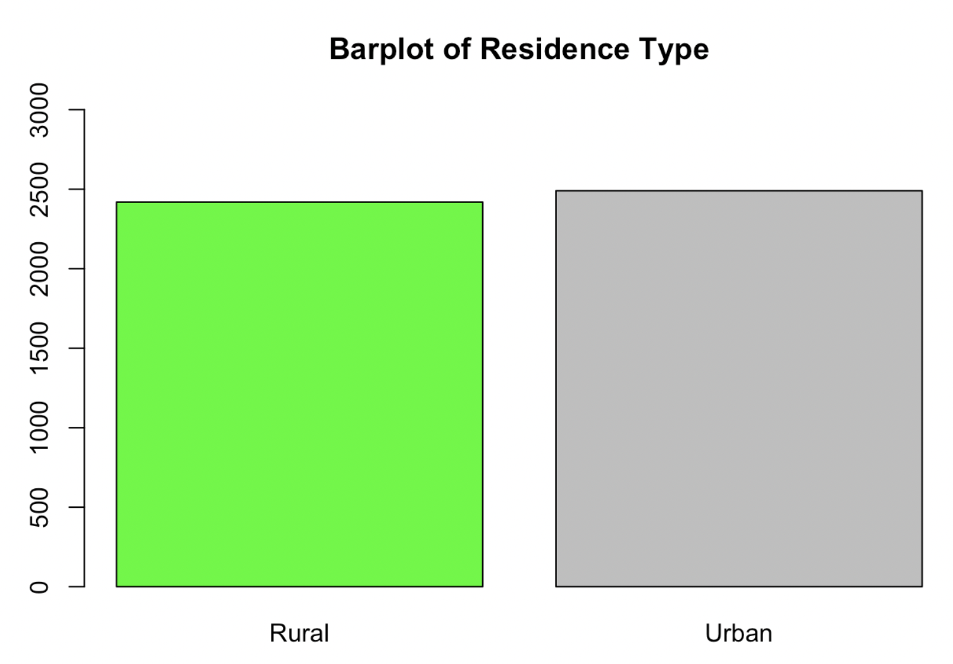
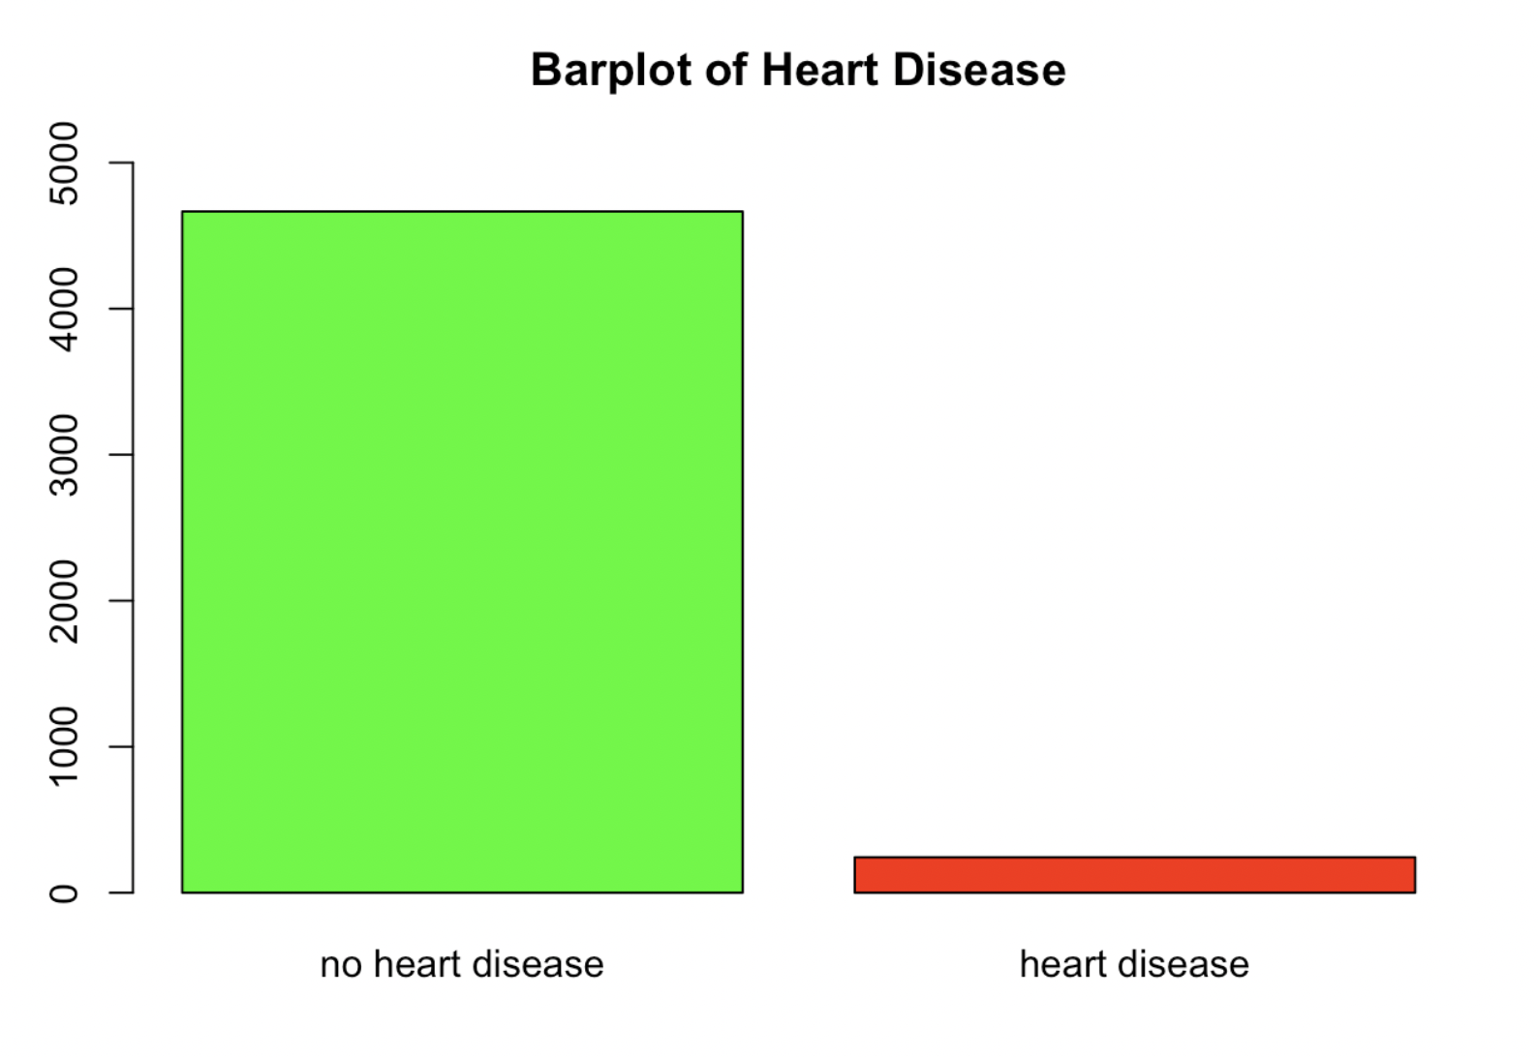
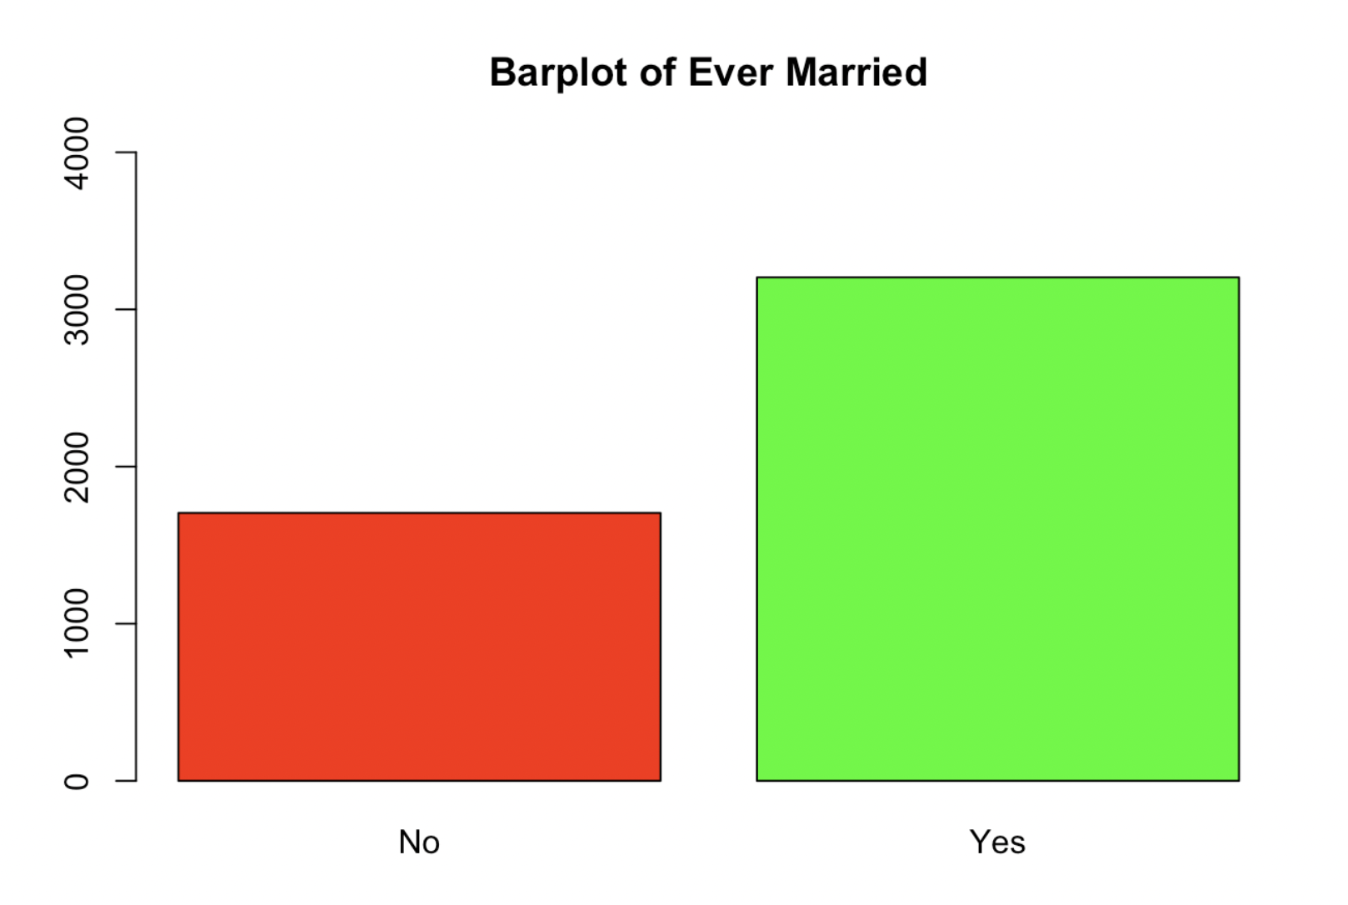
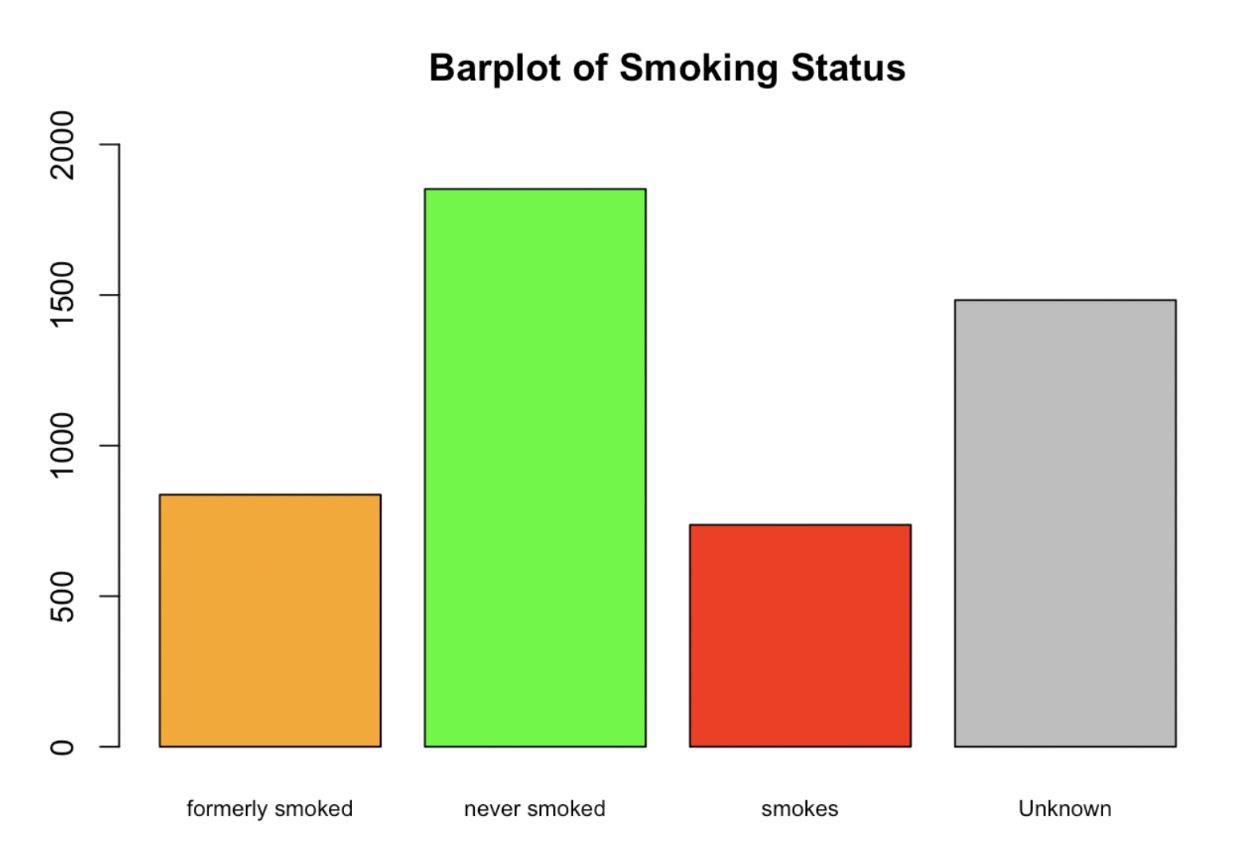
The dataset contains mostly binary variables. Is the dataset balanced with respect to these binary variables?

Slide 8
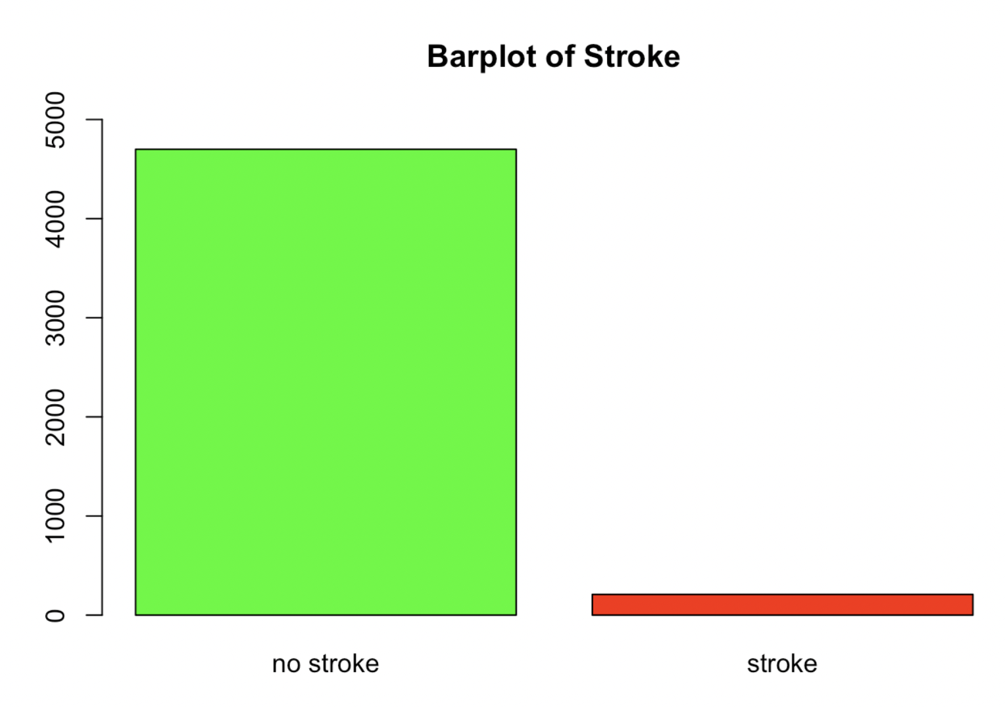

Slide 9
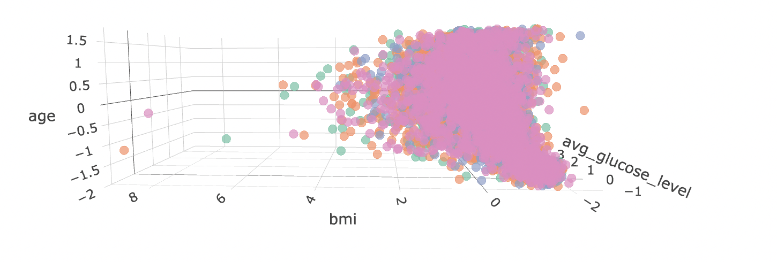
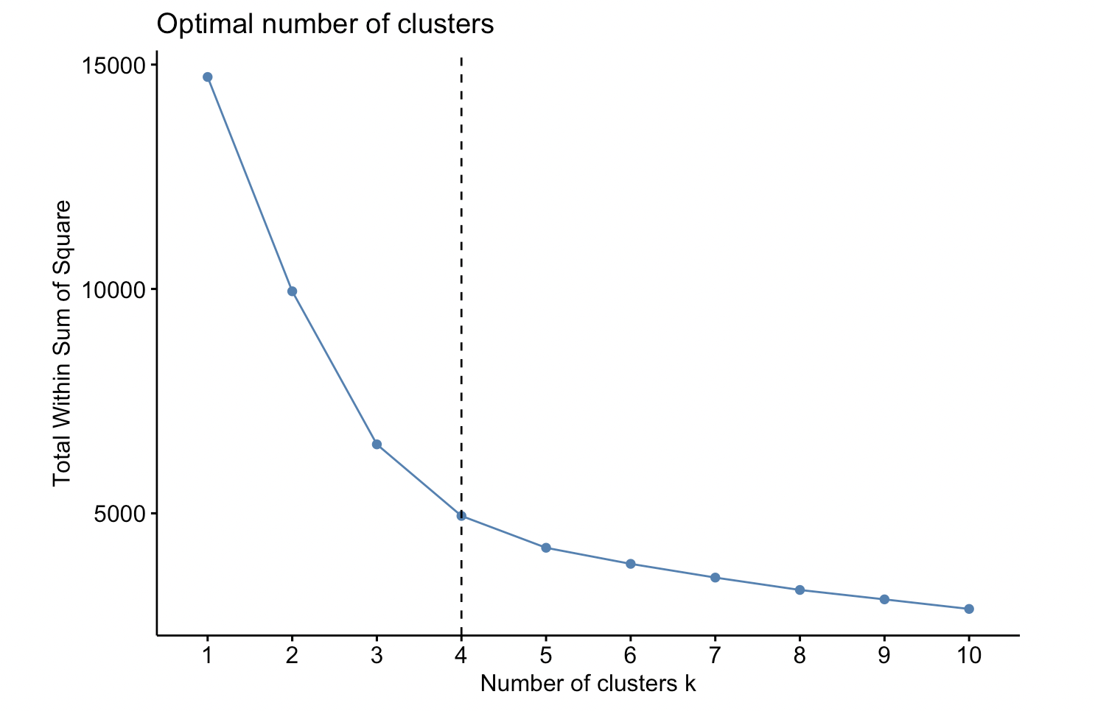
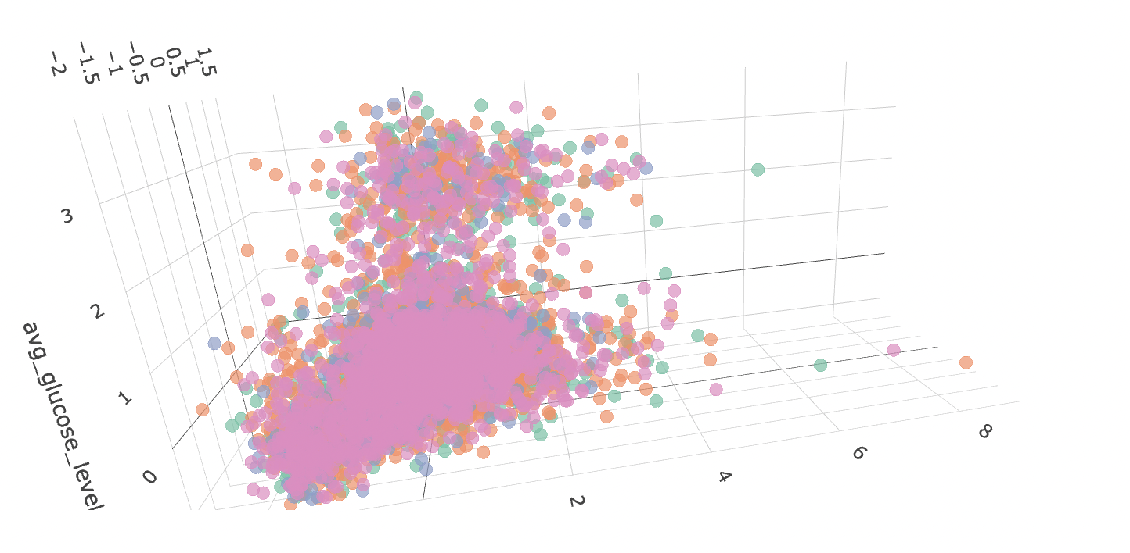
Is there any natural segmentation between people who have had a stroke or not based on their lifestyle habits (e.g. Bmi, glucose level etc)?

Slide 10

There don’t seem to be any prominent clusters of data, so there is no natural clustering between the participants of this study.

Slide 11
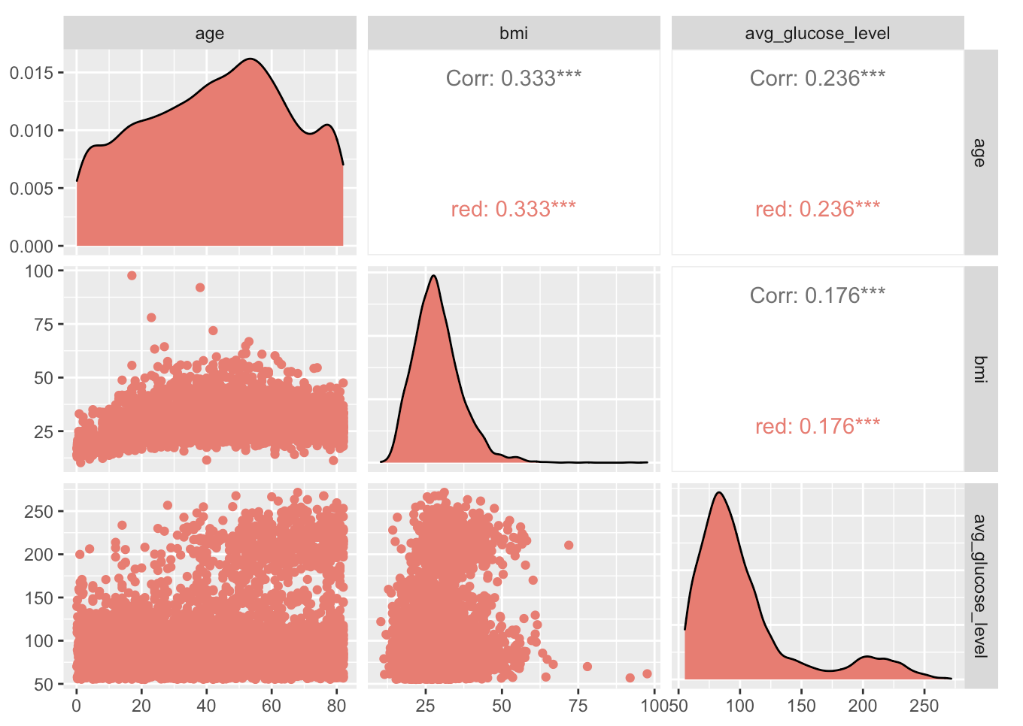
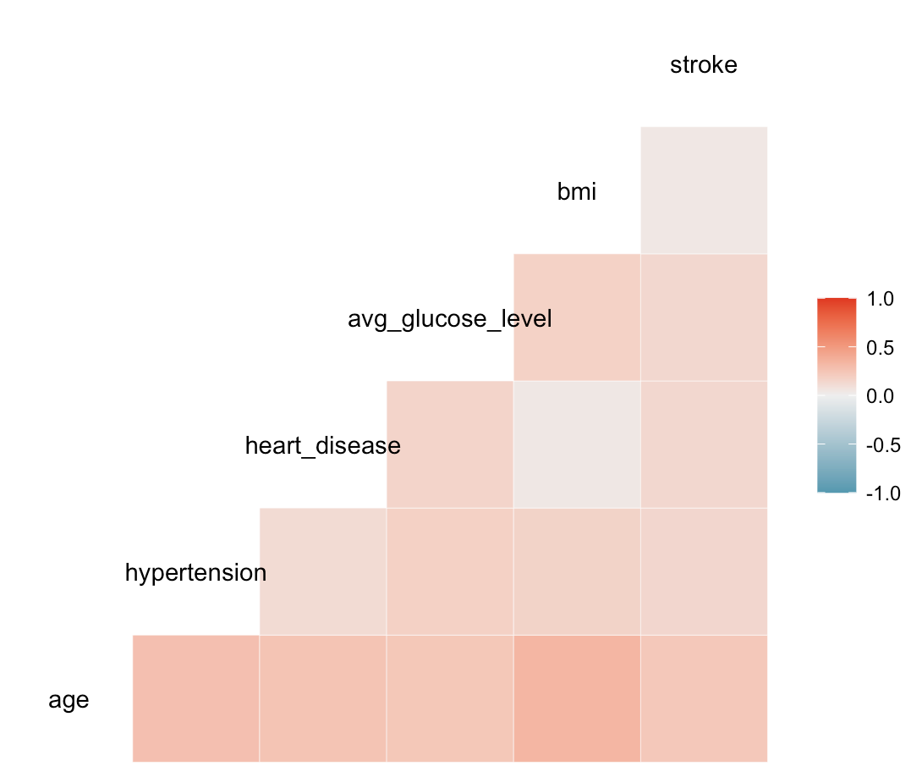
Is there any significant linear relationship between the variables in this dataset (age, bmi, avg_glucose level)?
There are no obvious strongly linear relationships between the continuous variables bmi, average glucose level and age. Thus, when we compute the model with stroke as dependent variable, we will not have to worry about multicollinearity.
The strongest correlated variables seem to be bmi and age, and then age and hypertension, but even these correlations are quite low.

Slide 12
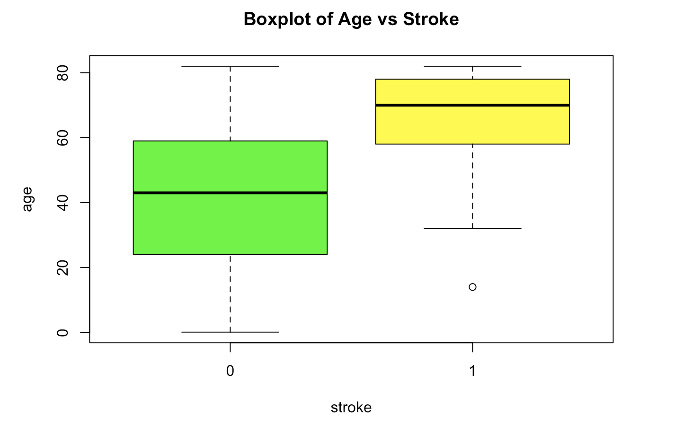
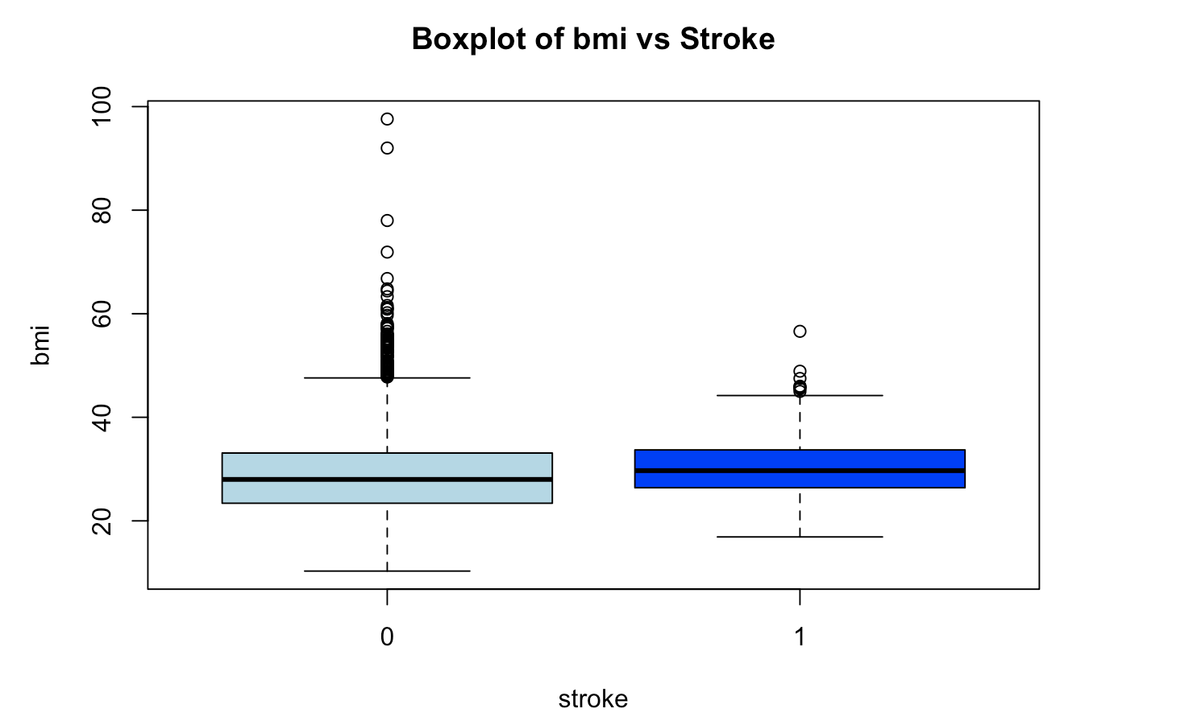
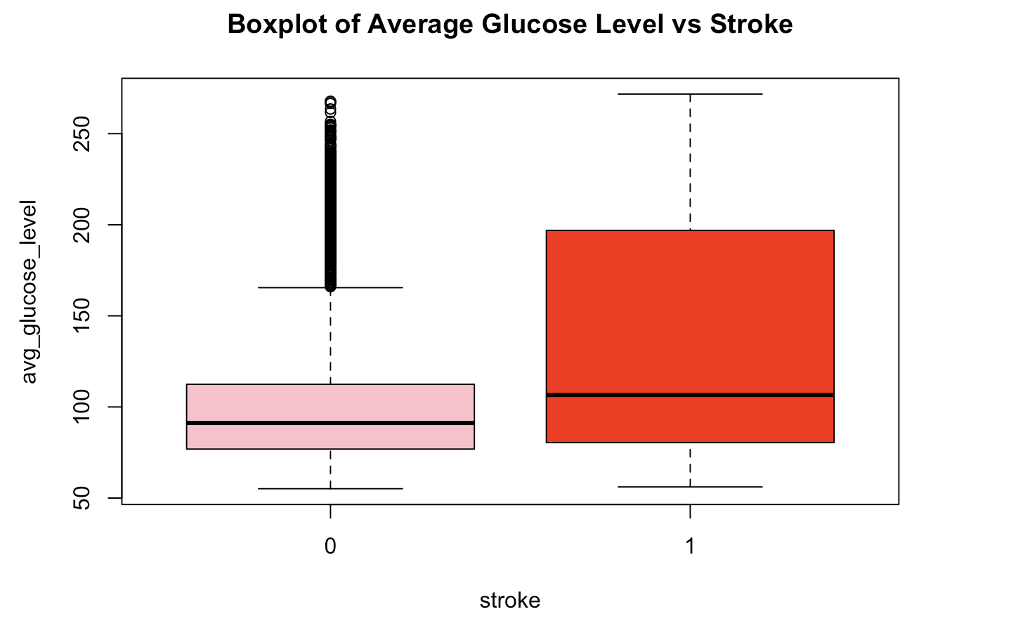
Are older people/people with higher bmis/people with higher average glucose levels more likely to suffer from stroke?

Slide 13

3.
Feature Selection

Slide 14
Since our main research question is
“What are the variables that best allow us to predict stroke for an individual?”,
we will try to do model selection using three methods:
Lasso Regression with the most appropriate value for lambda
Stepwise regression based on p-values
Backward Elimination
Forward Selection

Slide 15
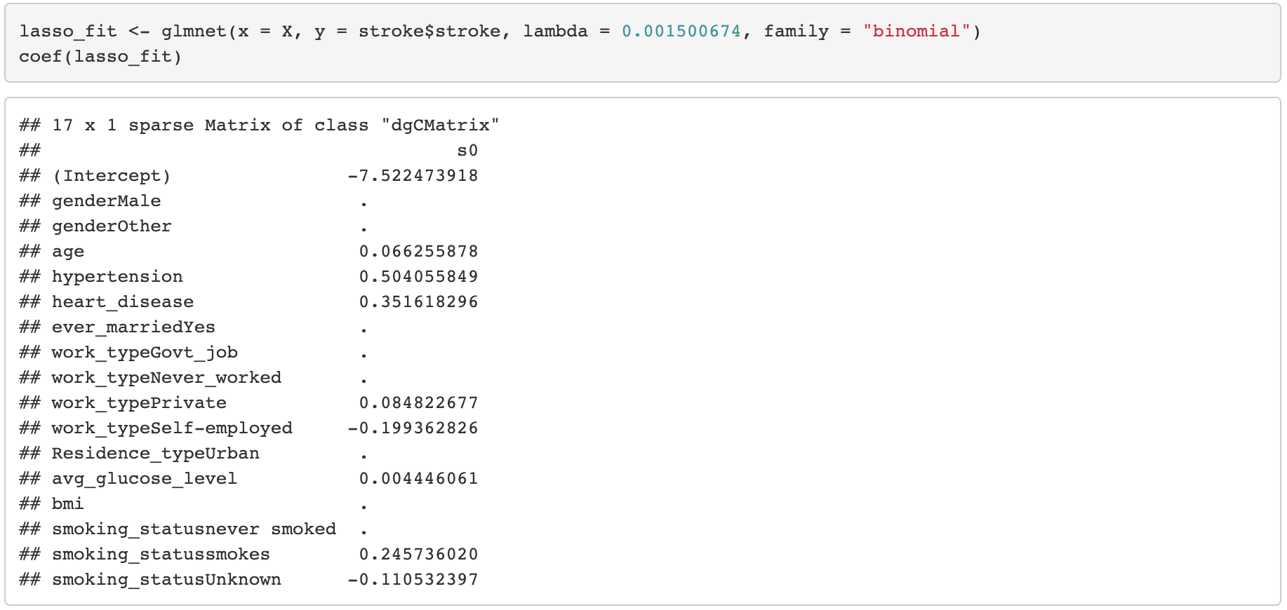
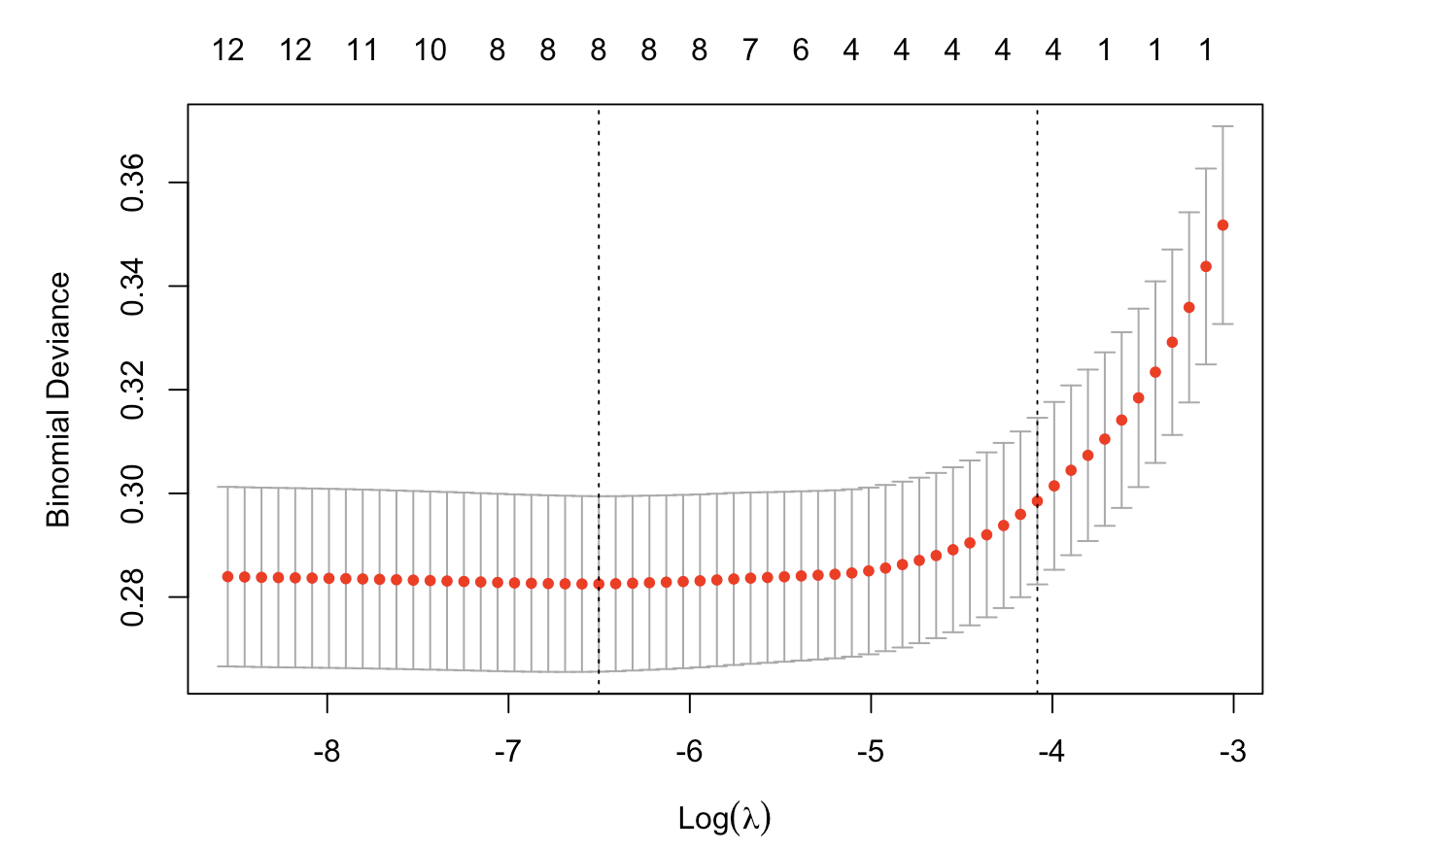
Lasso Regression for Model Selection
Lasso Regression has discovered
the following representative
attributes for predicting stroke:
age
hypertension
heart_disease
work_type
avg_glucose_level
smoking_status

Slide 16
To consolidate and examine the lasso regression, we used stepwise regression for model selection as well.
P-value Backward elimination
The model discovered by
backward elimination based on p-values contains:
age
hypertension
heart_disease
work_type
avg_glucose_level
ever_married
P-value Forward selection
Final model by forward
selection based on p-values
contains the following
attributes:
age
hypertension
avg_glucose_level
heart_disease

Slide 17
Since lasso, backward elimination and forward selection all yield different models, for the classification part we will stick to the results obtained via
Lasso regression (more reliable)
Forward selection based on p-values (yields a minimal model)

Slide 18

4.Prediction: Use decision tree and naive bayes to construct prediction model respectively using parameters obtained via lasso regression and forward selection

Slide 19
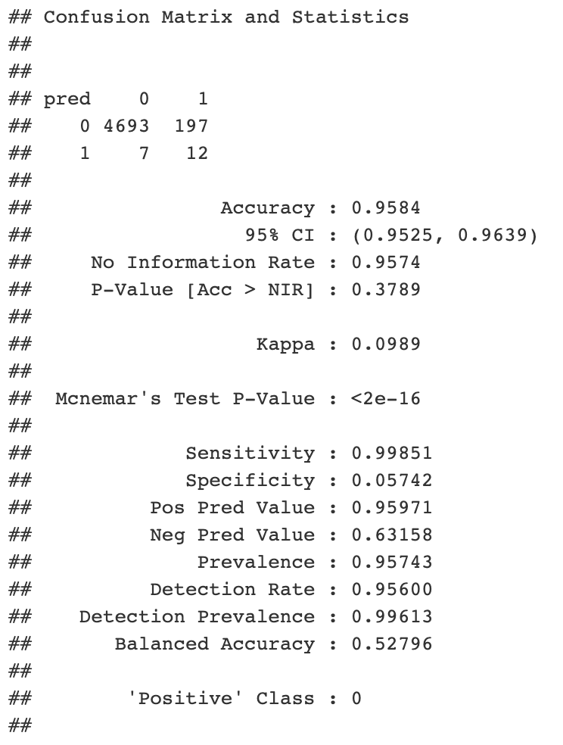

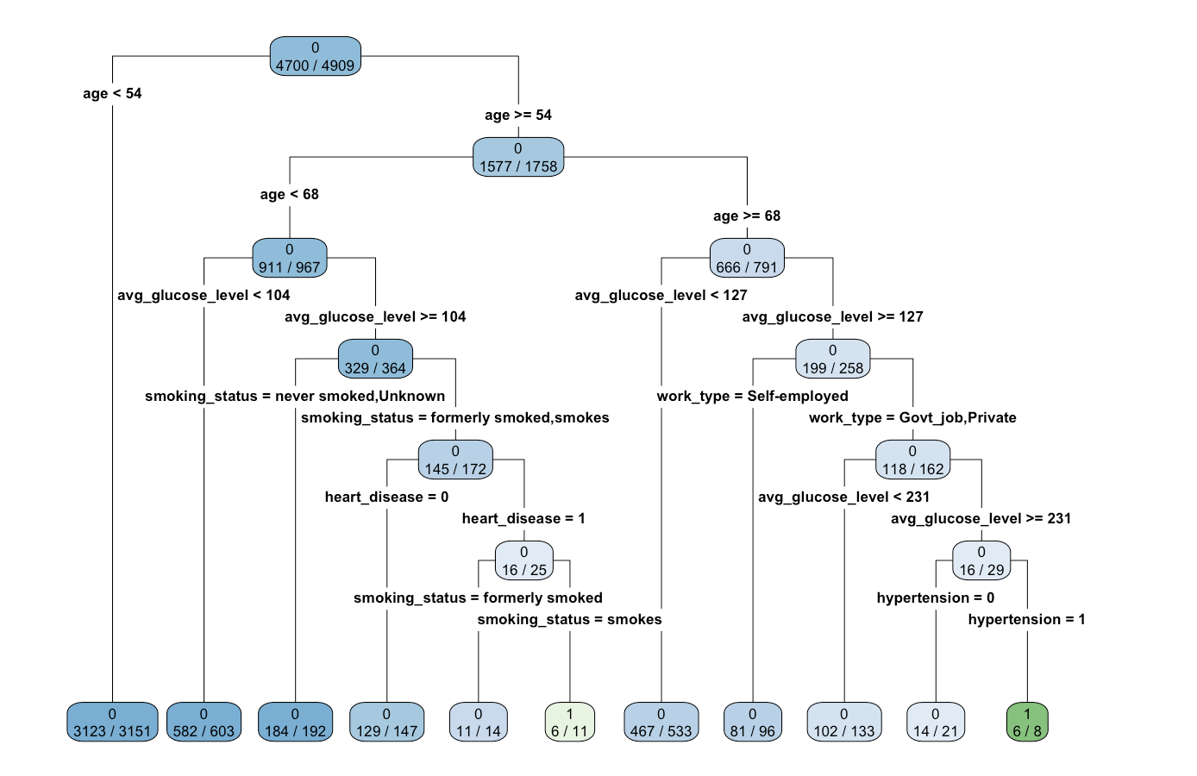
Decision Tree (with parameters from lasso regression)
For this decision tree, the number of false positives is very low at 7. On the other hand, the number of true positives is relatively good at 12. This seems like a moderately good model in terms of performance, because the number of false negatives is a bit high at 197.
In order to be classified as a positive, a person must be either:
older than 54 years, but younger than 65, with an average glucose level of 104 or more, currently a smoker, having heart disease or
older than 68, with an average glucose level of 231 or more, working for the government or at a private company, and having hypertension
PPV = 95.9% (quite high)
Detection Rate = 95.6%.

Slide 20

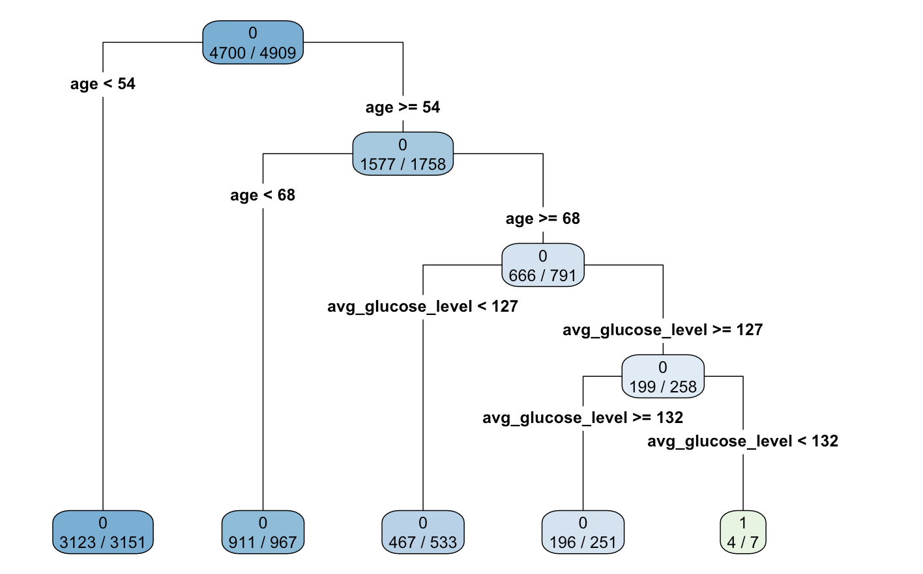

Decision Tree (with parameters from forward selection)
For the second decision tree, the situation is similar, in that the number of false positives is 3 and the number of true positives is 4. This seems to be an only moderately good model, unfortunately, in terms of performance, because, again, the number of false negatives is high at 205.
In order to be classified as a positive, a person must be older than 68, with an average glucose level between 127 and 132.
PPV = 95.8% (quite high)
Detection Rate = 95.6%.

Slide 21
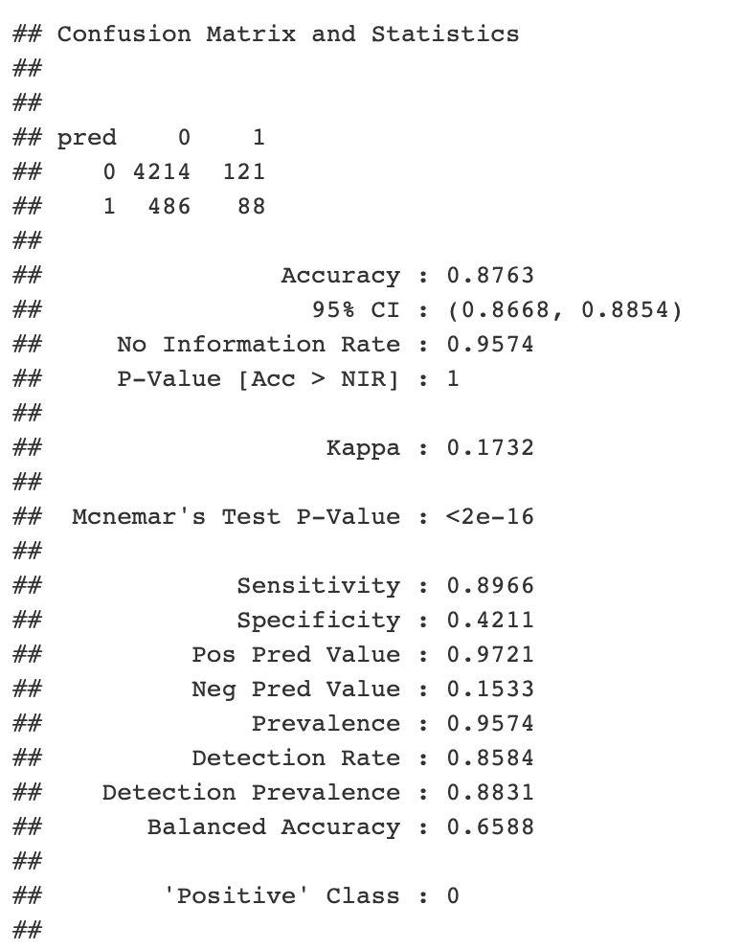

Naïve Bayes Prediction (with parameters from Lasso Regression)
Our second option was to do a Naive Bayes classifier, in the hope that we will obtain more reliable results:
The results from the first Naive Bayes classifier are indeed a lot more reliable. The model did classify some instances as 1, with 121 false negatives and 88 true positives. The accuracy is high at 87.6%, as well as the positive predictive value at 97%. The detection rate is 85%. All in all, this is a better classifier than decision tree.

Slide 22
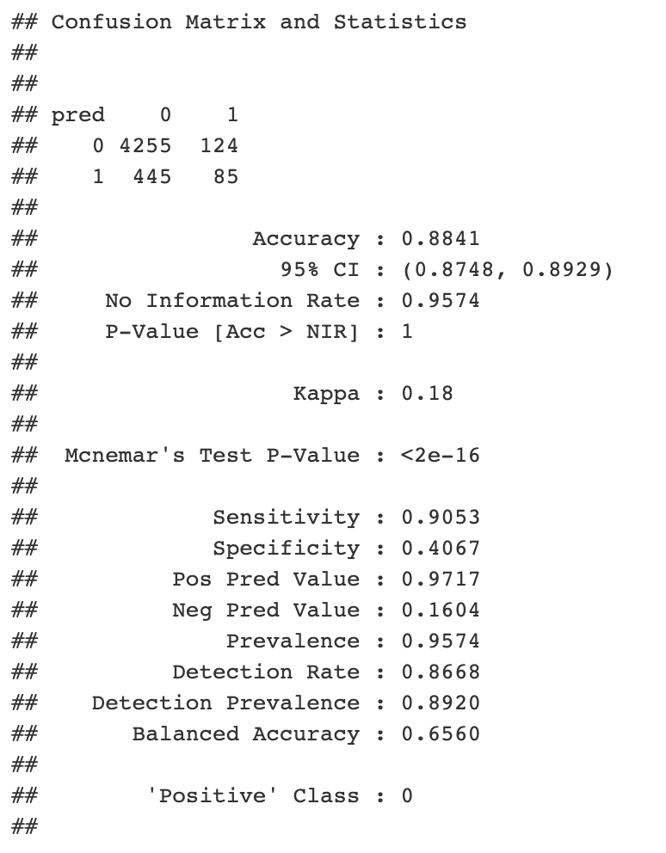

Naïve Bayes Prediction (with parameters from Forward Selection)
We also implemented another Naive Bayes classifier based on the minimal model discovered through forward selection based on p-values:
This model is comparable to the previous one. It yielded 124 false negatives and 85 true positives. The accuracy is 88.4%, and the positive predicted value is 97%. The detection rate is also higher at 86.68%.

Slide 23

5.
Conclusion

Slide 24

Since the Naive Bayes model with lasso regression predictors yield a higher number of true positives, along with more reliable accuracy and prediction outcomes, our team decides to choose this model as our optimal option.

Slide 25
Findings:
Curiously enough, bmi was not included in any classification model after feature selection, even though, from a practical perspective, we would expect it to be somewhat important.
Naive Bayes Classifier and Decision Tree seems to be relatively robust to imbalance in the dataset, and are better predictive models for stroke in this context.
Future Directions:
In order to build even better models in the future, we could try to counter the imbalance in the dataset by oversampling the minority class (~ 200 people, i.e. the people who had a stroke) or downsampling the majority class (~ 4700 people, i.e. the people who have not had a stroke).

Slide 26
THANK YOU!

